Slide 1

AP1201 Chapter 7
Thermal Properties of Matter (Chapter 18 of textbook)

Slide 2
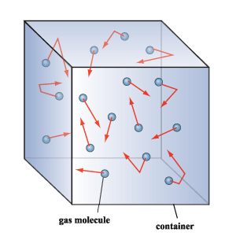
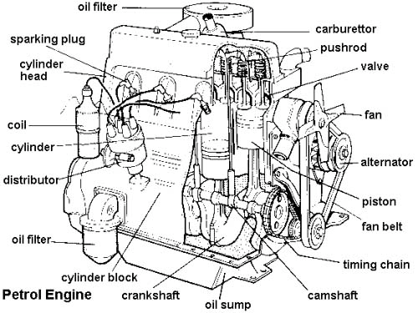
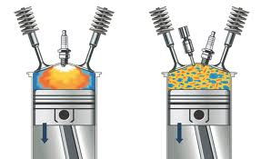
Objective and outline
To learn how thermal state of a gas changes and its possible application (thermal states of matters can be used in engines)
To understand the thermal properties in terms of microscopic behavior of atoms
Equation of state of a gas
Kinetic theory of gases: Random motion and kinetic energy of gas molecules
Heat Capacities of gases
Phases of matter, PVT surface and PV and PT Phase Diagrams

Slide 3
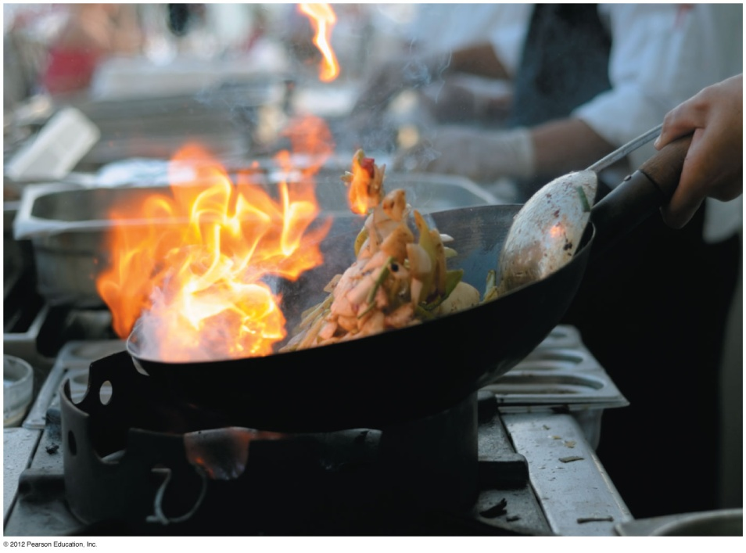
Introduction
We want to answer the following questions
What is the difference between hot and cold air in terms of atom’s behavior?
How do the motion of atoms of a gas relate to its temperature and pressure?
How does an engine or a refrigerator work?

Slide 4
Thermal State of matter
Matters can be in different thermal states, when the state changes, heat or work done is needed
This can be used in an engine
In an engine, the gasoline-air mixture explodes (gas is heated in the explosion, thermal state changes)
The gas in the engine expands and does work, pushes the wheel and the car. Heat converts into Work. The state of the gas is changing in the engine, when it is working.
Variables that describe the state of a matter are called state variables

Slide 5
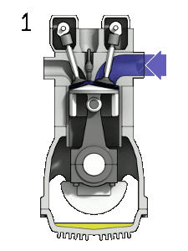
4 stroke engine cycle (animation)
https://en.wikipedia.org/wiki/File:4StrokeEngine_Ortho_3D_Small.gif

Slide 6
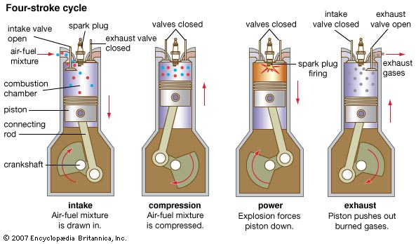
State Variables
We use some state variables to describe the state of the gas in an engine, usually, pressure, volume, temperature.
State variables are like position and time in mechanics, position and time describe motion (state of the object)
State variables describe the thermal state of a matter ( thermal behavior of the matter)
In an engine we use the change of thermal state of a gas to convert heat into mechanical work. In refrigerator, we can move heat from high temperature to low temperature using change of thermal states

Slide 7
Change of states of gas in an engine
Gas heat up (temperature increase)
Pressure increase
Gas expand (volume increase)
Gas cool down (hot air go to outside and suck in cold air-fuel mixture)

Slide 8
What is the Equation of State?
We use state variables (pressure, temperature, volume) to describe the state of a gas
These state variables are related by some laws (equations) which describe the behavior of the matter (gas) when the thermal state is changed.
The law is called equation of states
For ideal gas PV=nRT, pressure times volume is proportional to temperature. n is number of moles of gas, R-ideal gas constant. R=8.31JK⁻¹mole⁻¹
like Newton’s law for mechanics, relate force, position and time

Slide 9
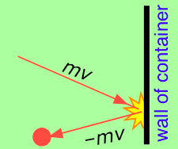
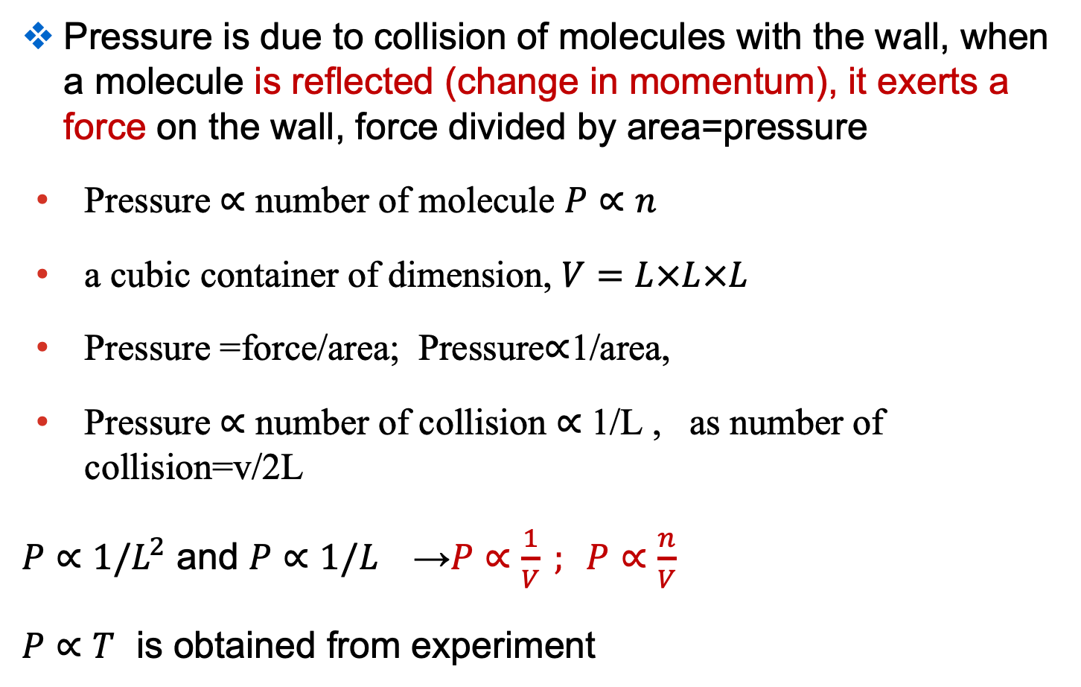
Brief explanation of ideal gas law
Pressure is due to collision of molecules with the wall, when a molecule is reflected (change in momentum), it exerts a force on the wall, force divided by area=pressure
Pressure $∝$ number of molecule $P∝n$
a cubic container of dimension, $V=L×L×L$
Pressure =force/area; Pressure$∝$1/area,
Pressure $∝$ number of collision $∝$ 1/L , as number of collision=v/2L
$P∝1/L^{2}$ and $P∝1/L^{}$ →$P∝\frac{1}{V} ; P∝\frac{n}{V}$
$P∝T$ is obtained from experiment

Slide 10
What is an ideal gas ? Can we find ideal gas?
Ideal gas is a gas whose pressure volume and temperature is related by the ideal gas law PV=nRT (ideal gas behavior)
At normal temperature and pressure, all gases have behavior resembling the ideal gas (not exactly, the same as the ideal gas, but close to the ideal gas behavior). They resemble one gas, the ideal gas
Usually at high temperature or low pressure, all gases behave like the ideal gas. In an engine, the gas’s behavior resembles an ideal gas, as the temperature is very high. After explosion, temperature around 1000 ºC.
In ideal gas, the atoms or molecules can be regarded as point particles (zero size). They can collide with each, but do not interact when they are not in collision (in same position).

Slide 11
Summary: Equations of state and the ideal-gas law
Quantities such as pressure, volume, temperature, and the amount of a substance are state variables because they describe the state of the substance.
The equation of state relates the state variables.
The ideal-gas law, pV = nRT, is an equation of state for an ideal gas. It relates the P V and T of an ideal gas
The molar mass M (molecular weight in gram) is the mass per mole. The total mass of n moles is m_{total} = nM.

Slide 12
Number of Moles and Avogadro’s number
The weight of one mole of substance equal atomic weight or molecular weight in gram. 12 gram of carbon-12 is one mole. Carbon has the atomic weight of 12. (it consists of atoms, use atomic weight, it consists of molecules, use molecular weight)
Oxygen atomic weight=16. one mole of oxygen is 16 gram of oxygen.
One mole of a substance contains as many elementary entities (atoms or molecules) as there are atoms in 0.012 kg of carbon-12.
One mole of a substance contains Avogadro’s number N_{A} of molecules or atoms. N_{A} = 6.022 x 10²³ molecules/mole
The molar mass M is the mass of one mole.
M = N_{A}m, where m is the mass of a single molecule or atoms.
Number of mole n=Mass of gas or solid/molar mass=W/M

Slide 13
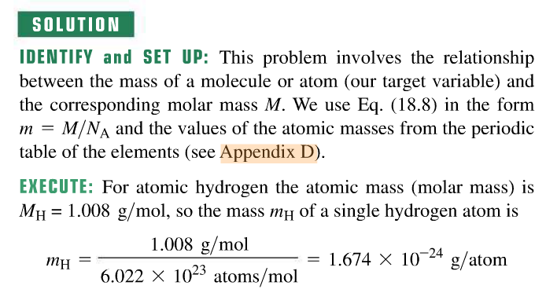
Moles and Avogadro’s number
Example 18.5: atomic and molecular mass
Find the mass of a single hydrogen atom and of a single oxygen molecule.

Slide 14
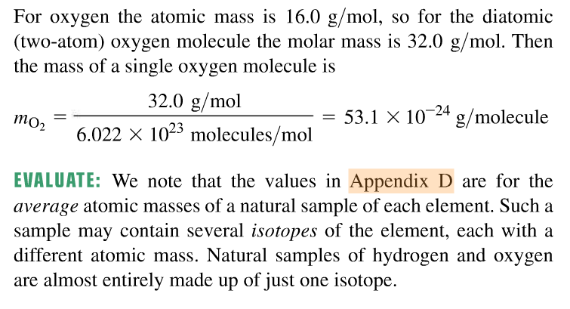

Slide 15
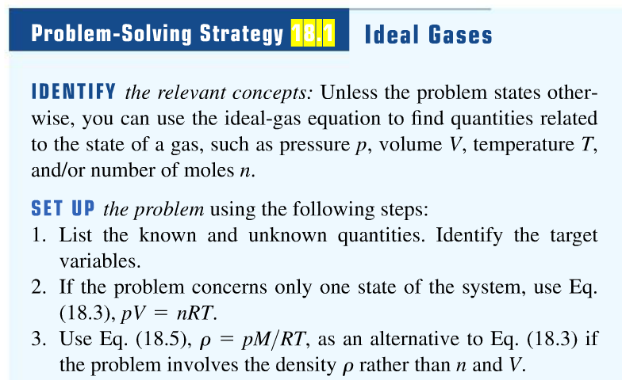
Equations of state and the ideal-gas law

Slide 16
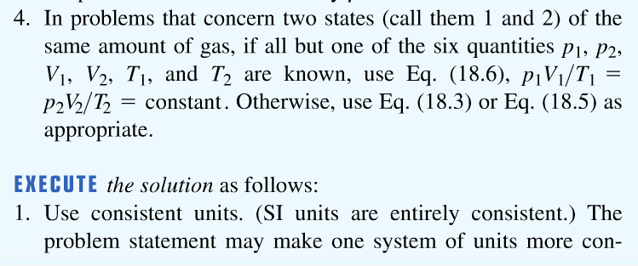
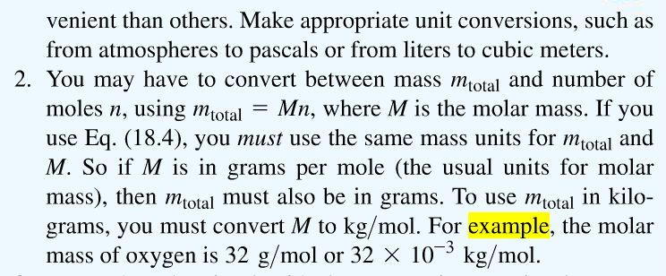

Slide 17
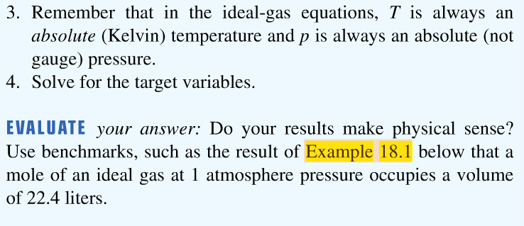

Slide 18
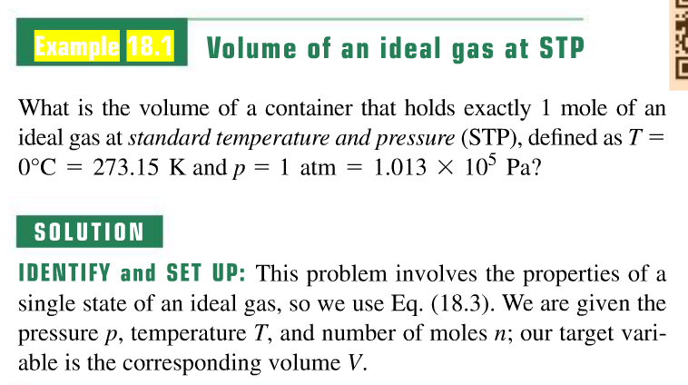

Slide 19
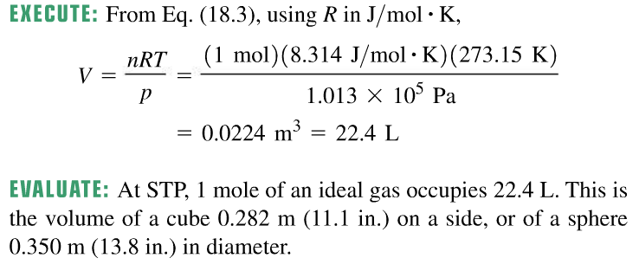

Slide 20
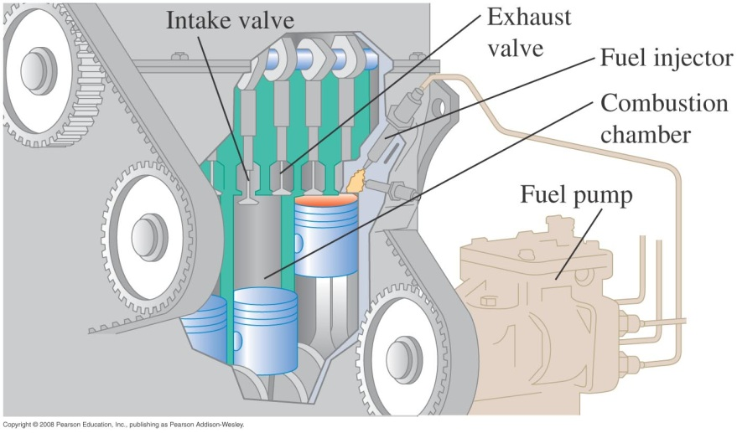
Example 18.2: Compressing gas in an automobile engine
In an automobile engine, a mixture of air and vaporized gasoline is compressed in the cylinders before being ignited. A typical engine has a compression ratio of 9.00 to 1; that is, the gas in the cylinders is compressed to 1/9.00 of its original volume. The intake and exhaust valves are closed during the compression, so the quantity of gas is constant. What is the final temperature of the compressed gas if its initial temperature is 27℃ and the initial and final pressures are 1.00 atm and 21.7 atm, respectively?

Slide 21
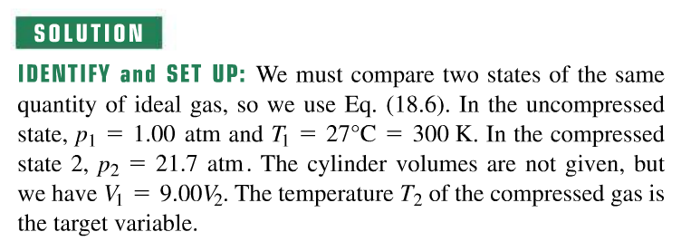
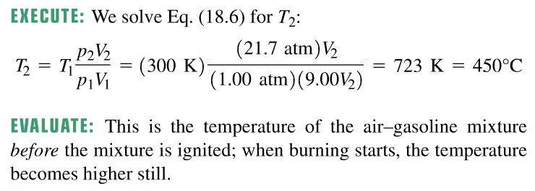

Slide 22
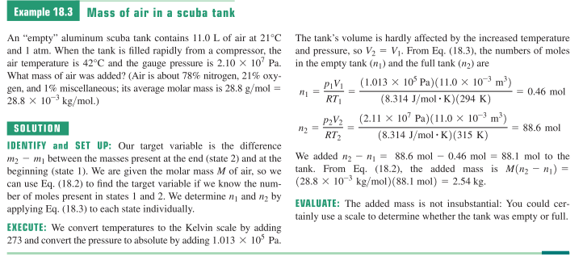
Two additional examples
Example 18.3: Mass of air in a scuba tank
An “empty” aluminum scuba tank contains 11.0 L of air at 21℃ and 1atm. When the tank is filled rapidly form a compressor, the air temperature is 42℃ and the gauge pressure is 2.10 X 10 ⁷ Pa. What mass of air was added? (Air is about 78% nitrogen,21% oxygen, and 1% miscellaneous; its average molar mass is 28.8 g/mol = 28.8 X10⁻³ kg/mol)

Slide 23
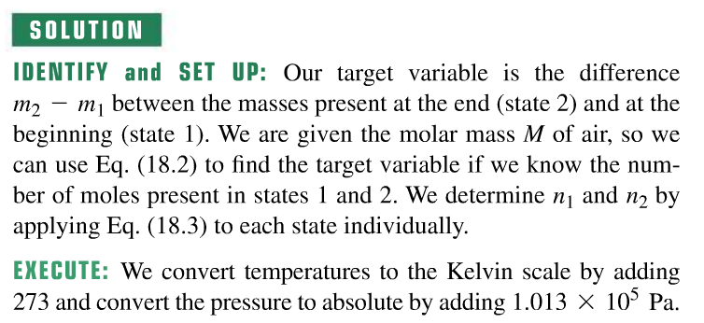
Two additional examples (18.3)

Slide 24
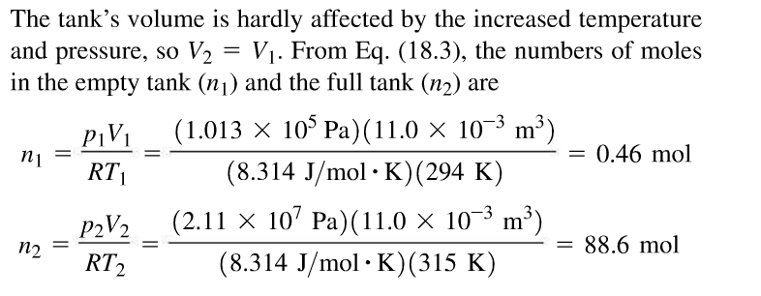
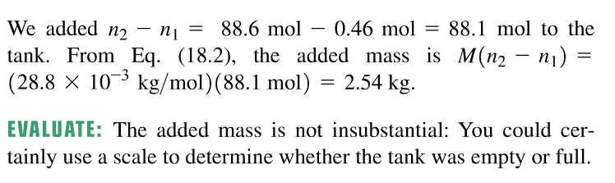

Slide 25
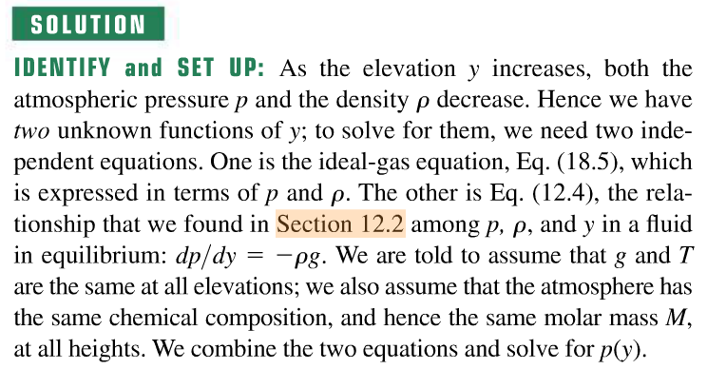
Two additional examples
Example 18.4: Variation of atmospheric pressure with elevation
Find the variation of atmospheric pressure with elevation in the earth’s atmosphere. Assume that at all elevations, T = 0℃ and g=9.80m/s².

Slide 26
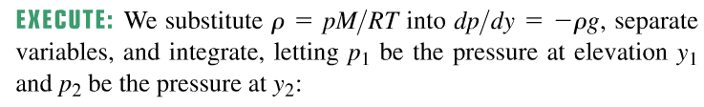
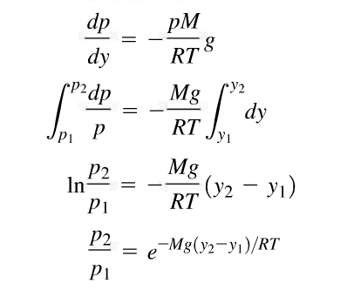

Slide 27
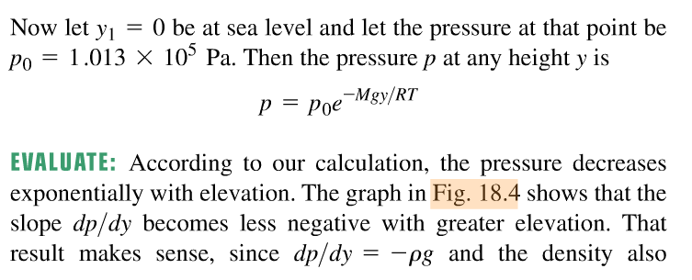
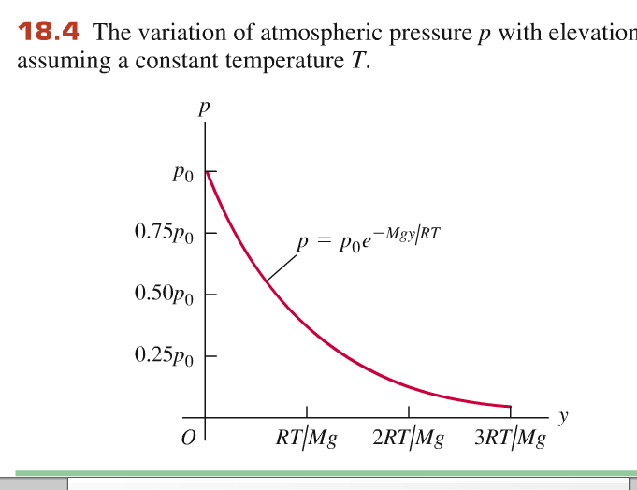

Slide 28
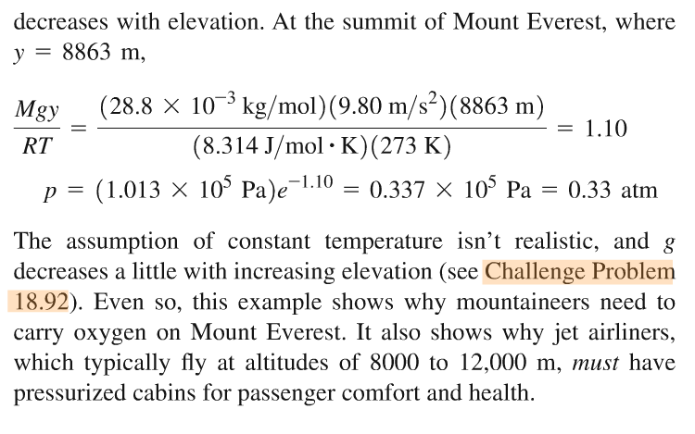

Slide 29
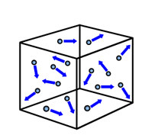
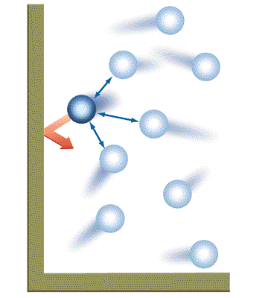
The van der Waals equation
In reality, molecules occupy space, have volume; molecules attracts each other
The model used for the ideal-gas equation ignores the volumes of molecules and the attractive forces between them. (See figure (a) below.)
The van der Waals equation is a more realistic model. (See figure (b) below.)
Ideal gas: volume of a molecule is negligible; no force between molecules
Real gas: molecules has volume; molecules attract each other

Slide 30
Meaning of the terms
an²/V² represents the effect of attractive force between molecules. Adding this term means the actual pressure is larger than the measured one. Since two molecules/atoms are involved in an interaction, it is proportional to the square of numbers.
nb represents the volume of the gas molecules. Molecules have size so the actually volume in which the molecules move is smaller.

Slide 31
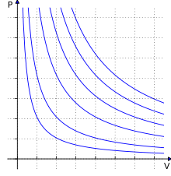
What are pV-diagrams?
Behaviour of a gas is useful for designing engines, refrigerator
It is necessary to know how p, V, T are related to design.
pV diagram is useful for showing the behaviour of a gas for a fixed temperature. Tell you how p changes with V.
A pV-diagram is a graph of pressure as a function of volume for different tempartures.
Figure opposite is a pV-diagram for an ideal gas at various temperatures.
T₁
T₂
T₃
We can use PV diagram to represents the processes in an engine

Slide 32
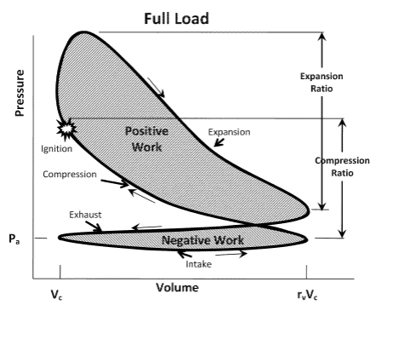
Example of using PV diagram
We use PV diagram to show the processes in an engine
4 stroke engine and its PV diagram

Slide 33
PT and VT diagram for ideal gas
PT diagram consists of straight lines showing P vs T
Slope proportional to inverse of volume
Volume A<B<C
VT diagram also consists of straight lines showing V vs T
Slope proportional to inverse of pressure

Slide 34
Microscopic model of matter
Properties of matter in terms of behavior of atoms and molecules

Slide 35
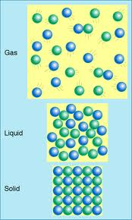
What are in gas, liquid, solid?
Gas, liquids, solids consist of molecules, atoms, or ions
Between them, there are attractive forces and replusive.
Distance between molecules is largest in gas > distance in liquid> distance in solids
Molecules in gas, liquid can move around
Molecules in solids are fixed in position
At finite temperature, they all have random motion

Slide 36
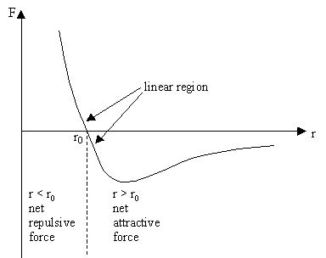
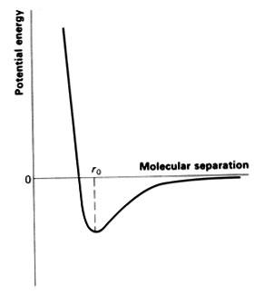
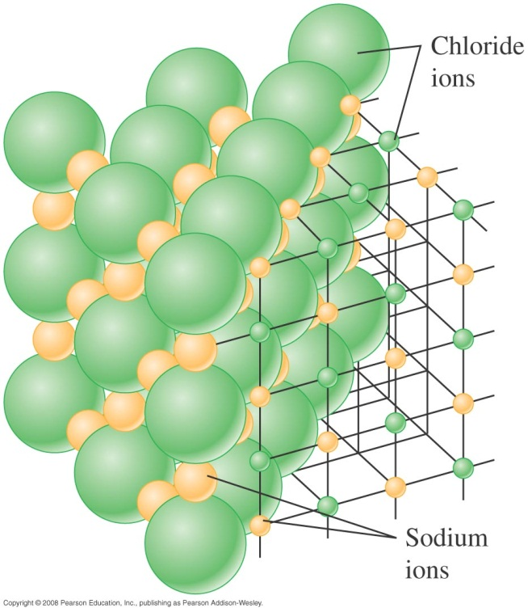
Force between atoms and molecules
Figure at the right shows how the force between molecules and their interaction potential energy depend on their separation r. Force is related to the slope of the potential energy by
Large separation: attraction between two molecules
Small separation: repulsion between two molecules
Low temperatures, gas becomes solid and liquid due to the attractive force.
F_{r}(r) = -dU/dr

Slide 37
Kinetic-molecular model of an ideal gas (kinetic theory)
We want to understand the ideal gas behavior through a kinetic molecular model
The assumptions of the kinetic-molecular model are:
A container contains a very large number of identical molecules.
The molecules behave like point particles that are small compared to the size of the container and the average distance between molecules.
The molecules are in constant motion and undergo perfectly elastic collisions. Video
The container walls are perfectly rigid and do not move.

Slide 38
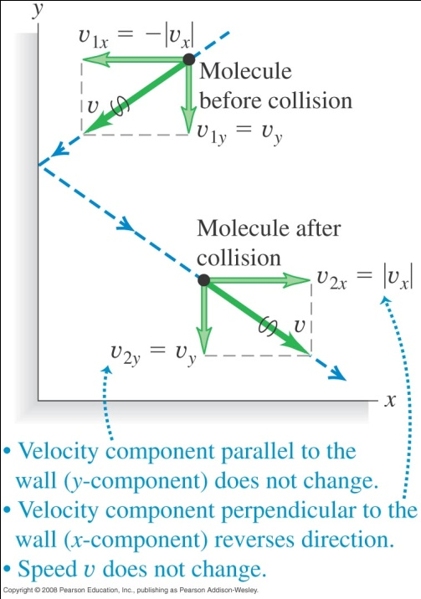
Relation between Collisions and gas pressure
Pressure is caused by the forces that gas molecules exert on the walls of the container during collisions.
After collision the direction of molecules’ motion is changed. This requires a force from the wall. According to Newton’s third law, the molecules exert a force on the wall
The two figures below show relation between collisions and pressure, molecular kinetic energies, and molecular speeds.

Slide 39
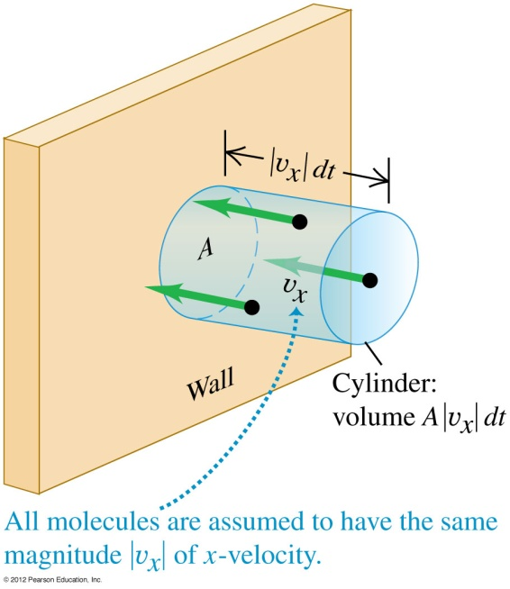
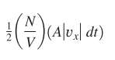
Collisions and gas pressure
The total momentum change associated with these collisions and the force needed to cause this momentum change:
m|v_{x} | - (-m|v_{x} |) =2m|v_{x} |
The number of collisions during time dt for a certain area A of wall. = the number of molecules within a cylinder (half of them) with base area A and length |v_{x} | dt that have their x-velocity aimed to the wall, which is
N is total number of molecules in volume V

Slide 40
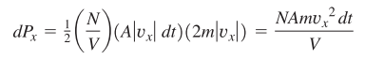
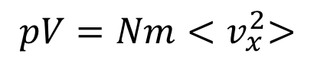
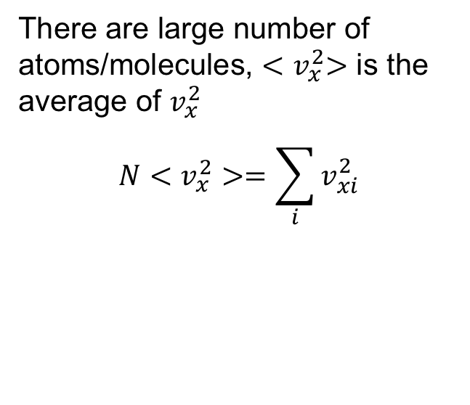
Collisions and gas pressure
The total momentum change during time dt
From this we can determine the pressure, which is force per unit area:
$$pV=Nm{<v}_{x}^{2}>$$
There are large number of atoms/molecules, ${<v}_{x}^{2}>$ is the average of $v_{x}^{2}$
$$N<v_{x}^{2}>=\sum_{i}{v_{xi}^{2}}$$

Slide 41
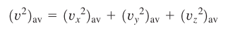
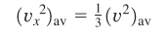
Pressure and Molecular Kinetic Energies
Averaged molecular speed
Eq. (18.11) becomes
Pressure multiplied by volume is proportional to the total kinetic energy of the molecules
K_{tr} is denoted as total translational Kinetic energy
Comparing to the ideal gas equation, we have

Slide 42
Random kinetic energy and temperature
PV is proportional to the total kinetic energy of molecules/atoms
PV is proportional to the temperature of the gas
This implies, total kinetic energy is proportional to temperature.
Temperature increases, total kinetic energy of the molecules/atoms is increased.
Molecules are in random motion, the kinetic energy is random kinetic energy

Slide 43
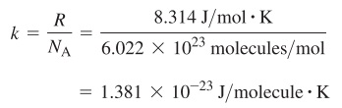
Pressure and Molecular Kinetic Energies
Average translational Kinetic energy of a single gas molecule is proportional to temperature T
or rewritten as
where k is called the Boltzmann constant:
Root-mean-square speed:

Slide 44
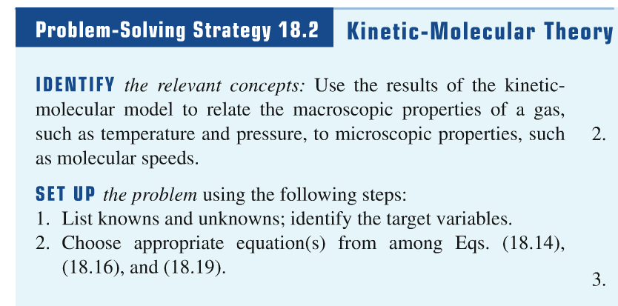
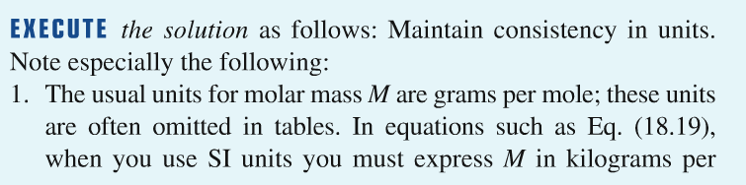

Slide 45
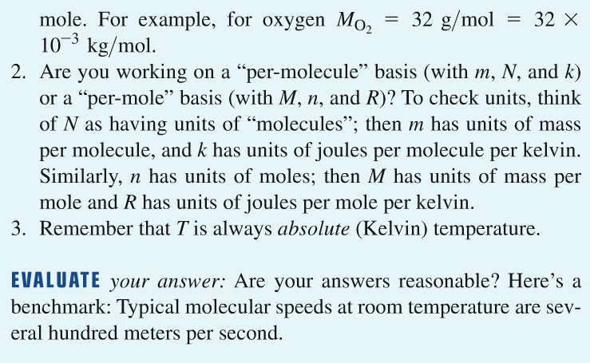

Slide 46
Collisions and gas pressure
Example 18.6: Molecular kinetic energy and v_{rms}
(a) What is the average translational kinetic energy of an ideal-gas molecule at 27℃?
(b) What is the total random translational kinetic energy of the molecules in 1 mole of this gas?
(c) What is the root-mean-square speed of oxygen molecules at this temperature?

Slide 47
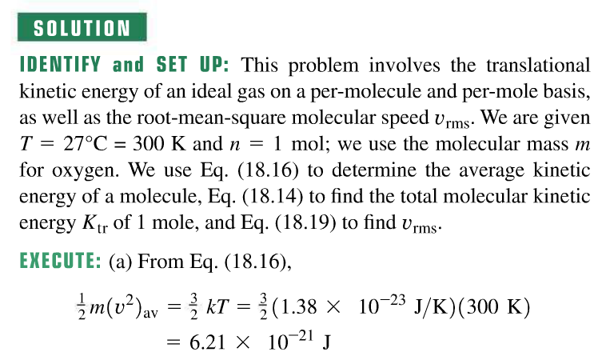

Slide 48



Slide 49

Collisions and gas pressure
Example 18.7: Calculating rms and average speeds
Five gas molecules chosen at random are found to have speeds of 500, 600, 700, 800, and 900 m/s. What is the rms speed? What is the average speed?

Slide 50


Slide 51

Collision between molecules/atoms in gases
Molecules/atoms in gases always collide with each other.
This determines how fast a molecule can move in a gas.
Useful for understand many important processes, such as diffusion

Slide 52

Collisions between molecules
We model molecules as rigid spheres of radius r as shown at the right. As the molecules move randomly in the gas, they collide with each other frequently
The mean free path of a molecule is the average distance it travels between collisions.
The average time between collisions is the mean free time.
N/V molecules per unit volume
Molecule ~ rigid sphere of radius r

Slide 53

Collisions between molecules
During dt, a molecule can collide with any molecules within the cylinder of radius 2r and length vdt
Number of collisions per unit time (factor sqrt(2) is due to the actual collisions are more frequent)

Slide 54


Collisions between molecules
Example 18.8: Calculating mean free path

Slide 55


Slide 56

Principle of equipartition of energy
Monoatomic gas : average kinetic energy=3kT/2
Three degree of freedom for a monoatomic gas
One degree of freedom has average kinetic energy kT/2
This applies to rotational degree of freedom too
One rotational degree of freedom: average KE=kT/2
$$\frac{1}{2}m\left\langle v^{2}\right\rangle =\frac{1}{2}m[\left\langle v_{x}^{2}\right\rangle +\left\langle v_{y}^{2}\right\rangle +\left\langle v_{z}^{2}\right\rangle ]$$
$$\left\langle v_{x}^{2}\right\rangle =\left\langle v_{y}^{2}\right\rangle =\left\langle v_{z}^{2}\right\rangle$$
$\frac{1}{2}m\left\langle v_{x}^{2}\right\rangle$=$\frac{1}{2}m\left\langle v_{y}^{2}\right\rangle$=$\frac{1}{2}m\left\langle v_{z}^{2}\right\rangle$=kT/2

Slide 57
Heat capacities of gases
The equipartition of energy principle states that each degree of freedom has 1/2 kT of kinetic energy associated with it.
We can derive the molar heat capacity at constant volume, C_{V}, for monatomic and diatomic gases and for solids. The results are C_{V} = 3/2 R for an ideal monatomic gas, C_{V} = 5/2 R for a diatomic gas
Temperature increases, kinetic energy increased, longer arrows mean higher kinetic energy

Slide 58



Heat capacities of gases
The degrees of freedom are the number of velocity components needed to describe a molecule completely. A monatomic gas has three degrees of freedom and a diatomic gas has six. Figure at below illustrates the motions of a diatomic molecule.

Slide 59
Degree of freedom in diatomic gas
Three translational, x, y, z, contribute to random K.E.
Two rotational degree of freedom, contribute to Random K.E.
Vibration is ignore as molecule is too rigid.

Slide 60

Compare theory with experiment
Table below shows that the calculated values for C_{V} for monatomic gases and diatomic gases agree quite well with the measured values. (ignore polyatomic gas, beyond the present level)

Slide 61

Extra: Heat capacities of ideal monatomic solid
C_{V} = 3R for an ideal monatomic solid

Slide 62
Molecular speed
Molecules move randomly in a gas
The speed is not uniform, some with high speed, some with low speed
There is a distribution of speed

Slide 63


Molecular speeds
The Maxwell-Boltzmann distribution f(v) gives the distribution of molecular speeds.
Area under the curve is the fraction of molecules with velocity in that range
Figure at the right helps to interpret f(v). Part (a) shows how the shape of the curve depends on temperature. Part (b) shows the fraction of molecules within certain speed ranges. The most probable speed for a given temperature is at the peak of the curve.
(derivation beyond scope)

Slide 64


Phases of matter
Depending on pressure and temperature
Matter can be in different phases: solid, liquid, gas
For example, at atmospheric pressure, temp>100ºC water is vapour, temp<100ºC water is liquid.
100ºC is boiling point at atmospheric pressure.
Boiling point depends on pressure

Slide 65
Phase diagram of a matter
Phase diagram is a diagram showing the relation between different phases of a matter
To understand phase diagram
We need to understand the PTV diagram first
First consider an ideal gas: pV=nRT
If we know p and V and we know T
So p, V and T are related and this relation is represented by a p V T surface

Slide 66

pVT-surface (diagram) for an ideal gas
Take a fixed amount of gas, measure its volume V its pressure and temperature P and T
Plot the values of P, V, T of the gas in a 3-D graph (P vs V and T), you have a PVT surface, it is smooth surface for ideal gas
The pVT-surface for a real gas is more complicatd than that for an ideal gas, as seen in the next slide.

Slide 67
Points on a PVT surface
Each point in the PVT surface gives the values of P V and T for a fixed amount of gas.
Each point represents a state of the gas.
For ideal gas, no liquid or solid phase, so PTV surface is smooth.
For real gas, owing to the attractive force between atoms or molecules, the solid and liquid phases are formed, the PVT surface is distorted, not smooth.

Slide 68

pVT-surface for a real gas
A pVT-surface graphically represents the equilibrium states of the gas. In reality it is distorted from the smooth surface for ideal gas.
Because solid and liquid phases of the gas can exist at low temperature. gas phase is found at high temperature
A point on the surface represents at this temp, volume and pressure, solid and vapor coexists
Resemble an ideal gas here, high temperature, low pressure
Distorted PVT surface

Slide 69
Liquid vapor coexist
Solid vapor coexist
Solid liquid coexist
Only solid exists
Only vapor exists
Only liquid exists

Slide 70



Use water ice, steam Dry ice as example.
Solid liquid coexist:
In melting ice, Ice and water coexist
Liquid and vapor coexist: boiling water, water and steam coexist, the bubbles consist of vapor (steam)
Dry ice is solid CO₂. Liquid CO₂ exist above 5 atmospheric pressure. Normal atmospheric pressure, soild CO₂ changes into gas CO₂ (Solid gas coexist)

Slide 71

PT and PV diagrams
PT and PV phase diagram can be considered as the projection of the PVT surface on the PT and PV plane

Slide 72
PV diagram
PV diagram is the projection of the PVT surface on the PV plane
It shows clearly how liquid is transformed into vapour and the region in which liquid and vapor coexist
It is useful for describing processes in which liquid change to vapor and vapor changes into liquid.
Also, it can be used to show the compression and expansion of vapor.

Slide 73
PV diagram for real gas
When pressure changes volume changes, the vapor is compressed or expanded
Liquid-vapor coexist here.
When volume increases, liquid change to vapor
Volume decrease vapor changes to liquid

Slide 74


Use of PV diagram to describe Refrigeration cycle in Refrigerator
4 steps:
Condensation: vapor changes to liquid, give out heat (feel warm at back of refrigerator)
Throttling: expansion through a valve, liquid becomes liquid+vapor
Evaporation: liquid changes to vapor, absorb heat (cool the food inside)
Compression: vapor compressed, vapor volume is decreased, need work done in this step

Slide 75
PT diagram for real gas
Project the PVT surface on the PT plane you get the PT diagram
It is useful for telling you which P and T values are for solid, liquid and gas phase only
And P and T values at which you can find the coexistence of two phases
Supercritical liquid

Slide 76

PT phase diagram
One phase only
Two phases coexist

Slide 77

PT phase diagram
Figure below shows a typical pT phase diagram, and the table gives triple-point data for some substances.
Smooth change
Supercritical liquid
Triple point, all three phases coexists
Critical point, above critical temperature and critical pressure, no distinction between liquid and gas, the state is supercritical liquid.

Slide 78


Below critical point, there are liquid and gas (vapor) phases
About critical point, no liquid and gas phases, only the supercritical phase
When temp and presssure increases, the separation boundary between liquid and gas disappear

Slide 79

Supercritical liquid
Matter above the critical temperature, critical pressure, no distinct between gas and liquid, no phase transition between liquid and gas. It is in a state of matter called super critical liquid.
Super critical liquid is compressible like a gas, apply pressure, volume changes, but it has the density of a liquid. Its behavior is a mixture of gas and liquid.
It can have industrial application as its density is easily controllable by compression.

Slide 80
Summary
Ideal gas law, behavior of gas, (useful in engine, refrigerator)
Kinetic theory, gas behavior in terms of molecules random motion
Random kinetic energy proportional to temperature
Phases of matter, gas, liquid, solid
phase diagram, triple point, critical point.

Slide 81
TQ7.1
p
This p-V diagram shows three possible states of a certain amount of an ideal gas.
Which state is at the highest temperature?
3
2
1
A. state #1
B. state #2
C. state #3
D. Two of these are tied for highest temperature.
E. All three of these are at the same temperature.
V
O
Notes:
Answer: C

Slide 82
TQ7.2
Consider two specimens of ideal gas at the same temperature. The molecules in specimen #1 have greater molar mass than the molecules in specimen #2. How do the rms speed of molecules (v_{rms}) and the average translational kinetic energy per molecule (KE) compare in the two specimens?
A. v_{rms} and KE are both greater in specimen #2.
B. v_{rms} is greater in specimen #2; KE is the same in both specimens.
C. v_{rms} is greater in specimen #2; KE is greater in specimen #1.
D. v_{rms} and KE are the same in both specimens.
E. None of the above is correct.
Notes:
Answer: B

Slide 83
TQ7.3
You have a quantity of ideal gas in a cylinder with rigid walls that prevent the gas from expanding or contracting. If you double the rms speed of molecules in the gas, the gas pressure
A. increases by a factor of 16.
B. increases by a factor of 4.
C. increases by a factor of 2.
D. increases by a factor of 2^{1/2}.
Notes:
Answer: B

Slide 84
TQ7.4
If the pressure of the atmosphere is below the triple-point pressure of a certain substance, that substance can exist (depending on the temperature)
A. as a liquid or as a vapor, but not as a solid.
B. as a liquid or as a solid, but not as a vapor.
C. as a solid or as a vapor, but not as a liquid.
D. as a solid, a liquid, or a vapor.
Notes:
Answer: C

Slide 85
TQ7.5
You have 1.00 mol of an ideal monatomic gas and 1.00 mol of an ideal diatomic gas whose molecules can rotate. Initially both gases are at room temperature. If the same amount of heat flows into each gas, which gas will undergo the greatest increase in temperature?
A. the monatomic gas
B. the diatomic gas
C. Both will undergo the same temperature change.
D. The answer depends on the molar masses of the gases.
Notes:
Answer: A

